Slide 1
Lab-7

Slide 2
BLOB Detection
Blob detection is a basic method in computer vision used to locate areas of interest in a picture.
Blob detection is the process of finding related areas in an image that share features.
It assembles linked pixels into clusters.
Applications for blob detection include image segmentation, feature extraction, object tracking, etc.
Note:- you can apply various morphological, smoothing operations in combination before apply blob detector function for better results.
To improve blob detection performance, image preprocessing, including noise reduction, contrast enhancement, and color space conversions.

Slide 3
Techniques
Laplacian of Gaussian (LoG): Gaussian-smoothed image's Laplacian is the method used here.
Most accurate but slowest
Difference of Gaussian (DoG):DoG algorithm computes the difference between two Gaussian-smoothed pictures.
Faster approximation of LoG
Determinant of Hessian (DoH):Uses the determinant of the Hessian matrix.
Here, local curvature of an image is represented by the Hessian matrix.
Fastest Method

Slide 4
Steps and Functions Used
Load libraries and images.
Set Up the Simple Blob Detector
cv2.SimpleBlobDetector() (old version)
cv2.SimpleBlobDetector_Create ()
cv2.SimpleBlobDetector_Params()
Create keypoints detector using .detect(img) function
Obtain Key Points on the Image cv2.drawKeypoints( )
Display using cv2.imshow() function
DoG, LoG and DoH
from skimage.feature import blob_dog, blob_log, blob_doh

Slide 5
# Simple blob detector
import cv2
import numpy as np;
# Read image
im = cv2.imread("blob.jpg", cv2.IMREAD_GRAYSCALE)
# Set up the detector with default parameters.
detector = cv2.SimpleBlobDetector()
# Detect blobs.
keypoints = detector.detect(im)
# Draw detected blobs as red circles.
# cv2.DRAW_MATCHES_FLAGS_DRAW_RICH_KEYPOINTS ensures the size of the circle corresponds to the size of blob
im_with_keypoints = cv2.drawKeypoints(im, keypoints, np.array([]), (0,0,255), cv2.DRAW_MATCHES_FLAGS_DRAW_RICH_KEYPOINTS)
# Show keypoints
cv2.imshow("Keypoints", im_with_keypoints)
cv2.waitKey(0)

Slide 6
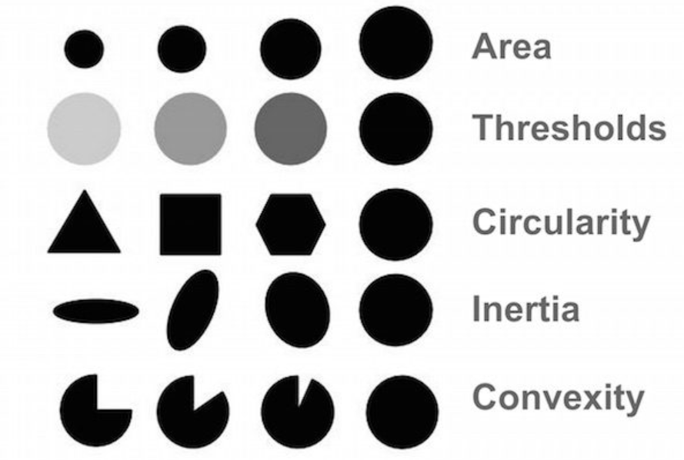
Parameters

Slide 7
# Setup SimpleBlobDetector parameters.
params = cv2.SimpleBlobDetector_Params()
# Change thresholds
params.minThreshold = 10;
params.maxThreshold = 200;
# Filter by Area.
params.filterByArea = True
params.minArea = 1500
# Filter by Convexity
params.filterByConvexity = True
params.minConvexity = 0.87
# Filter by Inertia
params.filterByInertia = True
params.minInertiaRatio = 0.01
# Create a detector with the parameters
ver = (cv2.__version__).split('.')
if int(ver[0]) < 3 :
detector = cv2.SimpleBlobDetector(params)
else :
detector = cv2.SimpleBlobDetector_create(params)

Slide 8
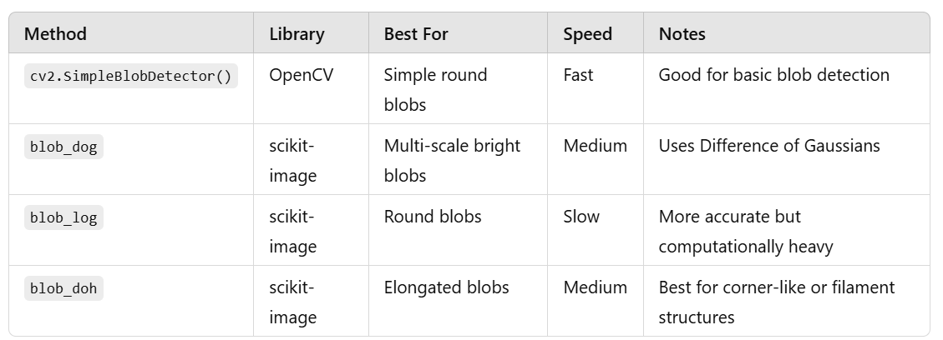
Comparison

Slide 9
Refs
https://towardsdatascience.com/image-processing-blob-detection-204dc6428dd/
https://github.com/AshishPandey88/Blob-Detection?tab=readme-ov-file
https://cyrillugod.medium.com/blob-detection-in-action-7425638f5347
https://mathematica.stackexchange.com/questions/310557/performant-blob-detection-in-images
https://www.geeksforgeeks.org/find-circles-and-ellipses-in-an-image-using-opencv-python/
https://www.geeksforgeeks.org/blob-detection-using-opencv/

Slide 10
Image quality enhancement
Adjusting brightness and contrast
Sharpening images
Removing noise from images
Enhancing color in images
Image resizing and scaling
Inverse Transform
Equalizing histograms
Super-resolution

Slide 11
Adjusting brightness and contrast
image2 = cv2.addWeighted(image, contrast, np.zeros(image.shape, image.dtype), 0, brightness)
# Adjusts the brightness by adding x to each pixel value
brightness = x
# Adjusts the contrast by scaling the pixel values
contrast = y
cv2.convertScaleAbs() function adjust the brightness and contrast using a combination of scaling and shifting the pixel values.

Slide 12
Sharpening images
cv2.filter2D() function or
cv2.Laplacian() calculates the Laplacian of an image.
The Laplacian is a second-order derivative, meaning it measures the rate of change of the rate of change of pixel intensities.
Removing noise from images
cv2.medianBlur() function
cv2.GaussianBlur()
Enhancing color in images
cv2.cvtColor() function after converting RGB to HSV and adjusts the hue, saturation, and value (brightness).
Image resizing and scaling
cv2.resize() function with cv2.INTER_NEAREST, cv2.INTER_LINEAR, cv2.INTER_CUBIC, and others.

Slide 13
Inverse Transform
inverse the color by simply subtracting each value from 255.
Equalizing histograms
cv2.equalizeHist() function and reproduce the image back.
Super-resolution
Use the pyrUp() and pyrDown() functions
Color correction
cvtColor() and inRange() function. To perform task like color balance, color grading, and white balancing.

